Slide 1
Introduction to Quantum Computing Concepts and Applications
Rohini V
GiQ Indian Ambassador | IBM Qiskit Certified Associate Developer

Slide 2
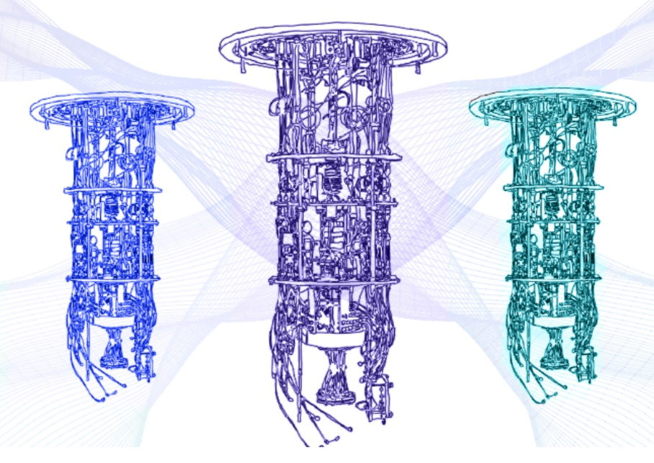
What is a Quantum Computer?
A quantum computer uses the properties of quantum mechanics to solve problems that classical computers cannot.

Slide 3
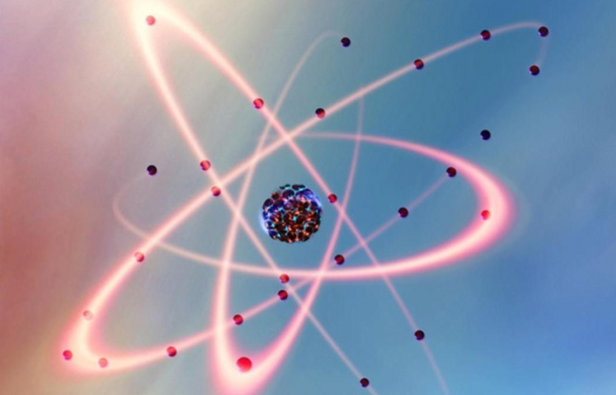
What is Quantum Mechanics?
Quantum Mechanics describes the behaviour of really small objects!
Quantum mechanics is the area of physics that studies the behaviour of particles at a microscopic level.

Slide 4
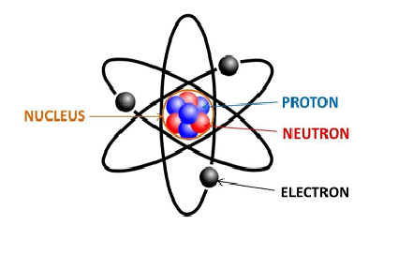
Quantum scientists discovered that these really small objects (like electrons, atoms, etc.) do not obey the laws of classical physics.
At subatomic levels, the equations that describe how particles behave is different from those that describe the macroscopic world around us.
Quantum computers take advantage of these behaviors to perform computations in a completely new way.

Slide 5
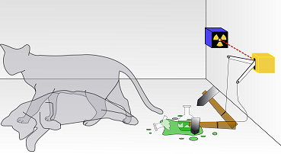
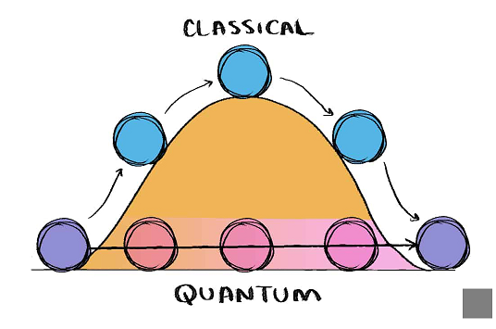
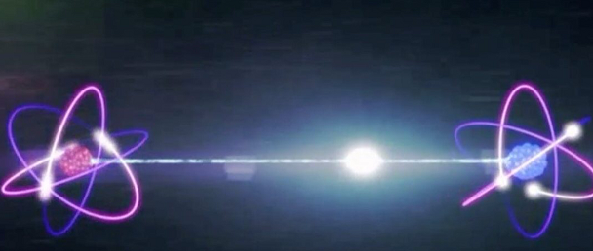
What happens in the “QUANTUM WORLD”
MAGIC IS SCIENCE THAT WE DON’T UNDERSTAND YET!
Objects can be in multiple place – SUPERPOSITION
Objects can pass through physical barriers – TUNNELING
Information can be teleported – TELEPORTATION

Slide 6
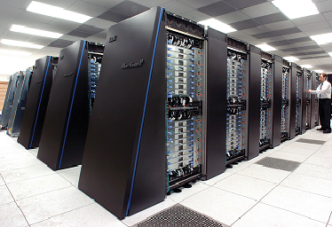
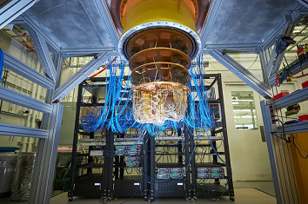
From the scratch!
The field of quantum computing is about harnessing these counterintuitive properties to make computing faster and powerful.
But we don’t make them just faster…
Quantum computers solve problems in a fundamentally different way.
This is the main key difference between a SUPERCOMPUTER and a QUANTUM COMPUTER.

Slide 7

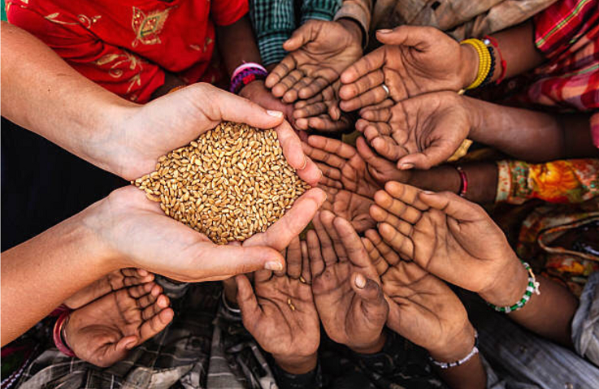
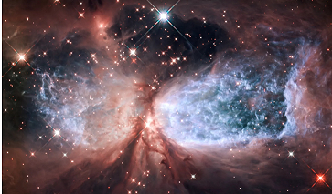
Real world Applications of Quantum Computing
What major issues could Quantum Computing Solve?
Climate change
End World Hunger
Astrophysics: We could find other planets and galaxies!

Slide 8
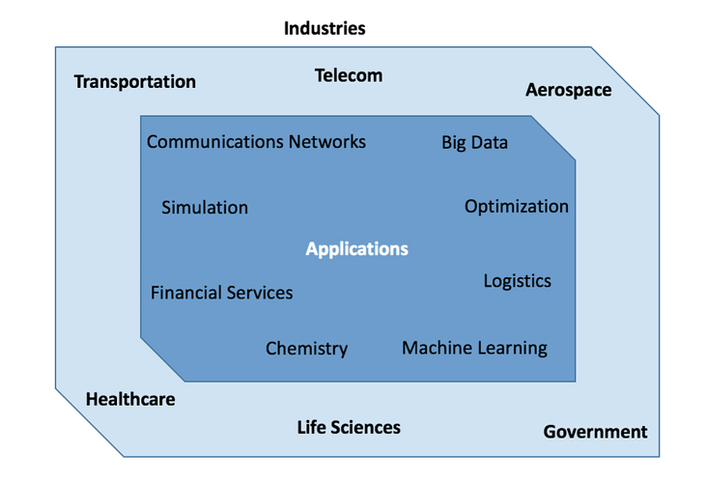
Quantum has applications in many fields!
Finance
Cyber Security
Biology
Chemistry
Aerospace
Robotics and Machine Learning
QUANTUM IS THE FUTURE

Slide 9
Quantum Advantage over Classical computers
Problems involving too much searching or testing for regular computers.
Problems that need secure encryption.
Problems that involve simulating quantum mechanical systems.

Slide 10
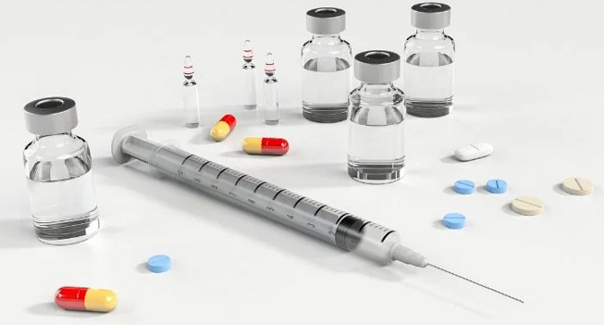
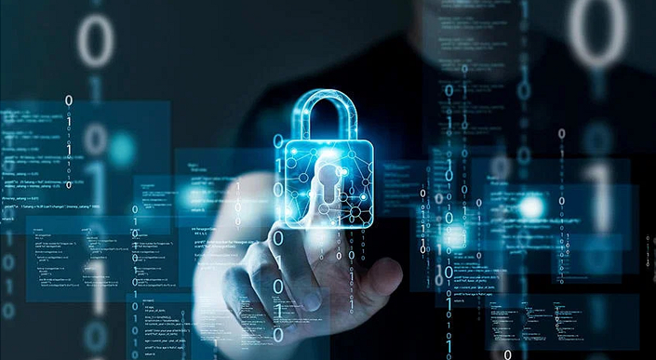
In the field of molecular biology: Vaccine development and Drug discovery are major applications
In the field of cyber security: Secure transfer information using Quantum Cryptography and Quantum Key Distribution

Slide 11
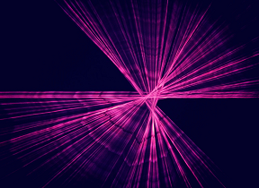
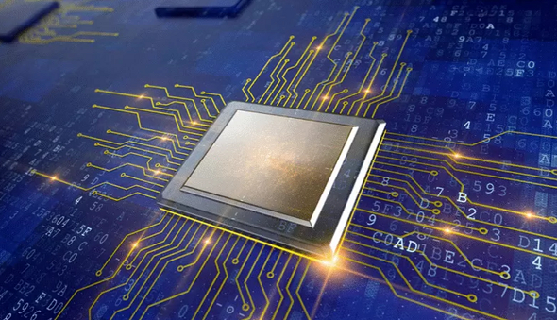
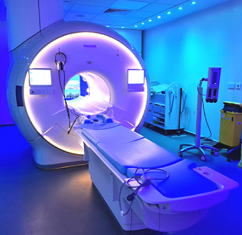
The HIDDEN Quantum
The Quantum is there, and is needed, but is still hidden!
We use Quantum in our daily life:
Computer Chips
Lasers
MRI Scans

Slide 12
What are Qubits?
Normal Computers/Classical Computers use bits (0/1), whereas Quantum Computers use Quantum Bits (Qubits).
Each Qubit can not only be set to 1 or 0, but it can also be set 1 and 0 or anywhere between 0 and 1 at the same time.

Slide 13


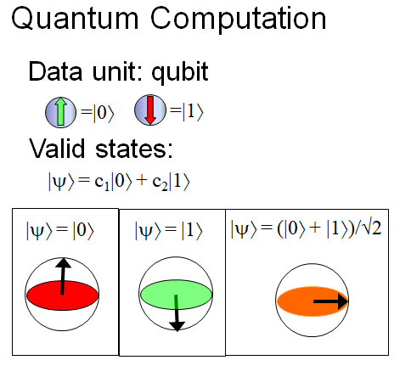



Classical Computation
Quantum Computation
Data Units : Bits
Data Units : Qubits
= ‘1’
= ‘0’
Valid states:
x = ‘0’ or ‘1’
x = 0
x = 1
0
0
1
1

Slide 14
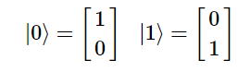
Representing Qubit States
Dirac bra-ket notation.
Representing states using vectors.
Vectors are well suited for describing quantities with a magnitude and direction

Slide 15
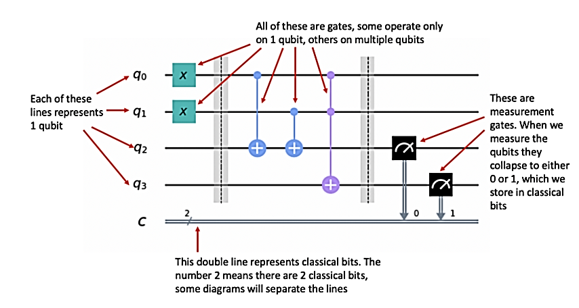
Quantum Circuit

Slide 16
Getting started with IBM’s Qiskit
Running algorithms on quantum computers essentially involves the following steps:
Passing a specified number of qubits into the system (circuit).
Applying a specified combination of gates (which make up an algorithm) to those qubits.
Measuring the qubits and storing the results in classical bits (in 0s and 1s).

Slide 17
List of Quantum Computers
• IBM Q
• Rigetti Aspen
• Google Sycamore
• D-Wave
• Ion Q Traps
• Xanadu Borealis

Slide 18
Quantum Computing Career
• Qubit Researcher
• Quantum Computer Architects
• Quantum Cryogenic Researcher
• Quantum Algorithmic Researchers
• Quantum Research Scientist
• Quantum Computer Developer
• Quantum Microwave Engineer
• Quantum Software Developer
• Quantum Control researcher
• Quantum User Experience Designers

Slide 19
In a nutshell…
Quantum Computer
Quantum Mechanics
In the quantum world
Supercomputer vs Quantum Computer
Applications
Quantum Advantage
Hidden Quantum
Qubits and representation
Quantum Circuit
List of quantum computers and quantum career

Slide 20
Thank you

